Slide 1
Did I change my game?
Reflection on the organisation of my training climate
2nd workshop for coaches
Notes:
Welcoming the participants
Describe the contents/objectives of the workshop
Reflection on the implementation of an empowering training climate
Benefits of the empowering training climate in practice
Anchoring a culture of prevention in the sports club by utilising the empowering training climate
Optional: Have name badges put up
Optional: Ask for expectations of the workshop, e.g. with the help of moderation cards

Slide 2
((Delete if necessary: Personal introduction))
Name
Profession
(insert further background info if desired...)
If applicable. Contact possibility
Notes:
Introduction of the speaker by name
You can introduce yourself using the PowerPoint slide or leave it for an oral presentation (without slide notes)
Delete slide if necessary

Slide 3
Workshop programme
Duration 90 min
Review of past workshops
Exchange of experience on the implementation of the empowerment climate
Anchoring "empowerment" and child protection in the club
Final round
Notes:
Describe the course of the workshop

Slide 4
Notes for workshop participants
Sensitive topic of violence:
Compliance with general rules of dialogue, e.g. respectful atmosphere, respecting the personal experiences of others
Participants may leave the room if necessary
Opportunity for discussion after the workshop
Offers of assistance:
If participants need support after the workshop, please get in touch with the presenter, the contact person at your organisation or a specialised counselling centre
Suitable counselling services:
  SafeSport contact point: https://www.ansprechstelle-safe-sport.de
  Nummer gegen Kummer: https://www.nummergegenkummer.de
  Help portal for sexual abuse: https://www.hilfe-portal-missbrauch.de/
Notes:
Notes for participants:
The content of the workshop can be potentially stressful, as it deals with sensitive topics such as sexualised violence.
This workshop is intended to provide a safe space: Other people's stories should be respected and not judged, and should not be publicised.
Allow participants to leave the room or take a break.
Please offer the opportunity for a discussion after the workshop.
Point out available offers of help:
If possible, also name a suitable local contact centre/contact person.
Please customise the fields marked in yellow

Slide 5
Review of past workshops
Safe Space Sports Club & Gamechanger
Notes:
Start with a thematic, interactive review of the past two workshops. In terms of teaching methodology, you are free to choose which organisational form/method you would like to use.
One simple option is to brainstorm with the entire group.
Depending on the group, more or less support is required for the review (give some pointers if necessary)
During the review, the following topics should be briefly recalled:
“Safe Space" workshop:
Children's rights
Key figures, definitions, effects of interpersonal violence
Bystander behaviour
Case studies
“Gamechanger" workshop:
Importance of the empowering training climate
Advantages and benefits
Implementation based on the six areas of empowerment
Optional
A PowerPoint slide has been put together for each of the points mentioned, which can be used to supplement the participants' dialogue if required

Slide 6

Children's rights and legal boundaries
Coaches, assistants and board members in sport
Assume Responsibility
Protect, promote and participate
In general:
When caring for children and young people, we are committed to the best interests of the child
Certificate of good conduct: People with a criminal record are excluded from working with children and young people
In the sports club, the first the first indications of boundary violations should be responded to in order to ensure a safe and supportive environment for children and young people.
Criminal law limits concern serious forms of violence.
(Sportjugend Hessen & MAKISTA)
Notes:
Use this slide to supplement the review of past workshops if necessary.
Detailed information on the content can be found in the workshop concept "Safe Space Sports Club".
Optional:
You can add the club's code of honour or rules of conduct at this point or insert them into the presentation.

Slide 7

Definitions and indicators of interpersonal violence
Forms & Frequency:
Psychological violence - 63% of athletes affected
Physical violence - 37%
Sexualised violence without physical contact: 26%
Sexualised violence with physical contact: 19%
Neglect - 15%
Special features:
There are few differences between recreational and competitive sport
Perpetrators are... peers, coaches, and both men and women
Assaults usually begin mostly in childhood and/or adolescence and affect both sexes
Consequences for those affected:
Sports-related: Less enjoyment of sport, quitting
Negative effects on child development and mental health
Physical effects: Declining performance, injuries
(Ohlert et al., 2020; Rulofs et al., 2016; World Health Organisation, 2002)
Notes:
For this and the following slides:
Use this slide to supplement the review of past workshops if necessary.
Detailed information on the content can be found in the workshop concept "Safe Space Sports Club".

Slide 8
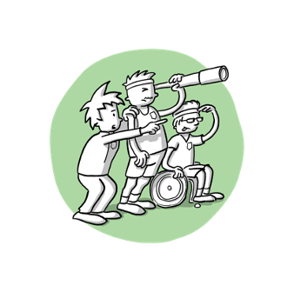
Reacting correctly as a bystander
 | Proactive Independent of incidents | Reactive In response to an incident
Positive | Further education and training Be a good role model Consideration of children's rights in sport, e.g. allowing young athletes to have a say | Intervene to put an end to the incident Stand by the person affected Inform parents Involve a contact person
Negative | Trivialisation of violence Promotion of (gender) discrimination Disregard for the opinions and rights of the athletes | Instigating or condoning the behaviour Taking part yourself Not giving any credence Playing down what happened
(McMahon & Banyard, 2012)
Notes:
Use this slide to supplement the review of past workshops if necessary.
Detailed information on the content can be found in the workshop concept "Safe Space Sports Club".

Slide 9
Empowering Coaching Climate
Promoting autonomy
Social support
Feeling of competence
Task orientation
3 basic psychological needs
Goal orientation
(Duda & Appleton, 2016; Duda, 2013)
Notes:
Use this slide to supplement the review of past workshops if necessary.
Detailed information on the content can be found in the "Gamechanger" workshop concept.

Slide 10
Empowerming climate
Consequences
Take care of all athletes equally, let everyone make a contribution
Involving athletes in decisions
Performance comparison with your own previous performance
Honour improvement, mistakes are part of learning
What counts is effort and willpower, not objective performance
Communication with athletes at eye level
Promoting mutual cooperation
Stronger motivation and greater effort
Fun, satisfaction and positive emotions
Perceived (subjective) competence
Useful strategies for dealing with stress
Positive relationships, fairness and less aggression among athletes
Better performance in competition (subjective and first indications of objective performance)
Leads to
(Appleton & Duda, 2016)
Notes:
Use this slide to supplement the review of past workshops if necessary.
Detailed information on the content can be found in the "Gamechanger" workshop concept.

Slide 11
Empowerment areas
Task
Autonomy
Recognition/
Perception
Grouping
Evaluation
Time
Steps to the introduction of the empowering climate:
Promotion of intrinsic motivation and therefore performance
Confidence in action for coaches
Offers at the same time protection from violence and false suspicions
(Ohlert et al., 2022;
Greither & Ohlert, 2023)
(Epstein, 1988, 1989)
Notes:
Use this slide to supplement the review of past workshops if necessary.
Detailed information on the content can be found in the "Gamechanger" workshop concept.

Slide 12
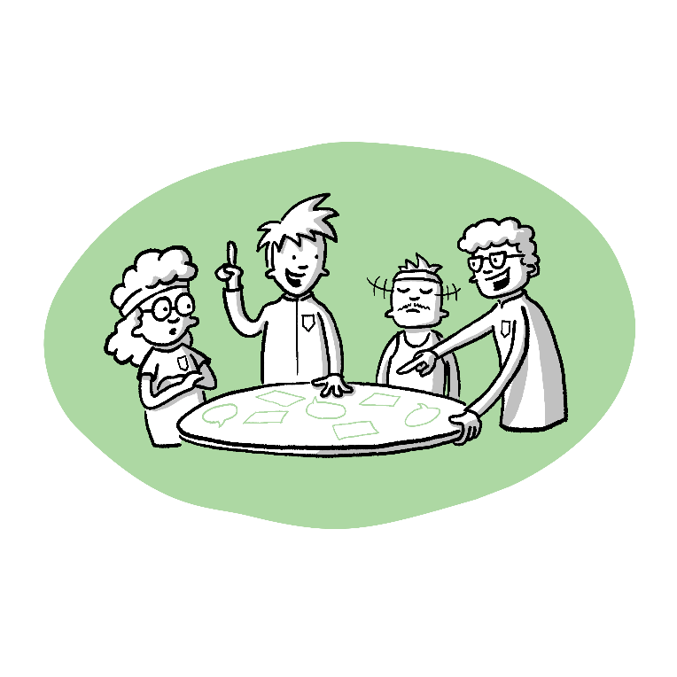
Implementation of the empowerment climate
Exchange of experiences and reflection on the practical phase
Notes:
In the weeks & months since the last workshop, the coaches have had the opportunity to consider the empowerment areas in the training and thus pay more attention to an empowering climate
Divide into small groups, 3-5 coaches per group
The participants should share with each other the extent to which they have implemented the empowerment areas
Optional
You can adapt the exercise to the group and use a different form of group work, e.g. work with the whole group, in pairs, mixed form

Slide 13

Questions for group work 1
Discuss for each empowerment area:
What were my goals as a coach after the first workshop?
Which areas was I able to implement well? Why?
Which areas were difficult to implement? Why?
Please use concrete examples from the training and write down your thoughts on each question and empowerment area
Notes:
The participants should discuss each of the empowerment areas in small groups with regard to the previous practical phase.
The handouts for the empowerment areas can be used again for this purpose.
The above guiding questions can remain displayed to support the discussion/reflection during the group work.
Select some suitable questions; alternative suggestions:
How well did the training sessions go overall?
How did the sports group react to certain changes?
How did I feel about the change in the training climate? (Own perception, emotions, difficulties)
Were there situations where the climate was disempowering? Why?
You can also label moderation cards with the six areas of empowerment and hang them up (for visualisation).

Slide 14

Presentation of results Group work 1
Were the goals set in the first workshop achieved?
Which areas were easy to implement?
Which areas were difficult to implement?
Self-perception as a coach:
  What has changed in your approach to training organisation?
  What thoughts/emotions came up?
In which situations was the climate rather disempowering & why?
+ general conclusion of each small group on the practical phase
Notes:
Optional
To support the presentation of results, you can show the coaches this assignment towards the end of the group discussion. Remove some of the points if necessary.
This makes it easier for participants to summarise key findings.
Alternatively, you can also use the previous slide (questions for the group work) or the following slide (summary of the group work) for the presentation of the results and let the coaches formulate them more freely.

Slide 15
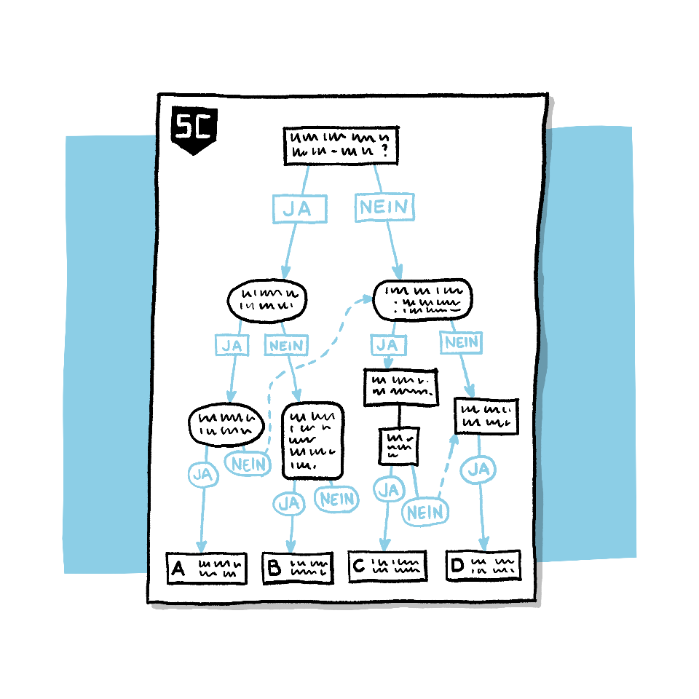
Conclusion on the practical phase
Notes:
At this point, the results are presented and secured.
Note down key aspects on flipchart/whiteboard/moderation cards.
At this point, summarise once again the insights gained by the participants.

Slide 16

Integration
How can coaches firmly integrate the issues of
preventing interpersonal violence and
fostering an empowerment climate
…into their training and the club?
Notes:
The final task is for the coaches to work out how what they have learnt can be implemented permanently in the club.
Introduce the task with selected questions:
The participants should work out how the topics of empowerment climate, prevention of interpersonal violence and child protection can be maintained and further developed in the long term
Work out which measures could be implemented by the coaches themselves
Work out how the club could provide support
Work out what is still missing (knowledge, methods, personnel deployment) and develop suitable solutions
Emphasise that coaches can take personal responsibility for the training climate
At the end, new goals should be formulated that can be realised within a foreseeable period of time (e.g. within 6 months, but this can be freely chosen)
The work assignments and key questions are formulated on the following slides.

Slide 17

Integration - Group work 2
Which goals do we set ourselves regarding...
  Preventing interpersonal violence?
  Implementing the empowerment climate in the training?
Which obstacles might there be on the way to these goals?
What responsibility do we bear for these issues?
Who can support us?
By when can these goals be achieved?
Notes:
The second group exercise is about concrete action planning:
Small groups of 3-5 people.
The participants should use the questions to formulate a number of goals and action plans that will help to establish a sustainable climate of empowerment and the prevention of interpersonal violence in the club.
Optional
You can also choose a different organisational form for the 2nd group work, e.g. working with the whole group or in teams of two.
Examples to explain the task:
Goals:
Prevention of interpersonal violence, e.g. regularly addressing it in meetings, developing rules of behaviour for interaction in the sports group
Implementation of the empowerment climate, e.g. better inclusion of athletes in training and competition planning
What obstacles could there be on the way to achieving these goals?
Lack of support from the athletes' parents
Lack of knowledge in relation to prevention measures
How do I deal with these obstacles?
Informational material to convince parents
Support from sports organisations (e.g. state sports association (LSB) or professional association)
Who can support me?
Contact persons from clubs or associations
Coaches/colleagues from the club
How soon can I achieve these goals?
Rules of conduct for coaches are developed within 4 weeks and then discussed with athletes und dann mit Sportler*innen besprochen

Slide 18
Integrating empowerment
Summary of the group work
Goals
Obstacles
Need for support
Timescale
Notes:
At the end of the group work, the small groups should present their results
Then summarise the key findings/goals, e.g. on a flipchart or cards
The aim is a lively exchange of ideas and realistic implementation options
If there is enough time, allow the participants to agree concrete plans and objectives among themselves
Support the participants in consolidating these ideas; e.g. one of the participants could formulate an e-mail/electronic note or a reminder where these ideas/goals are shared again with everyone.

Slide 19
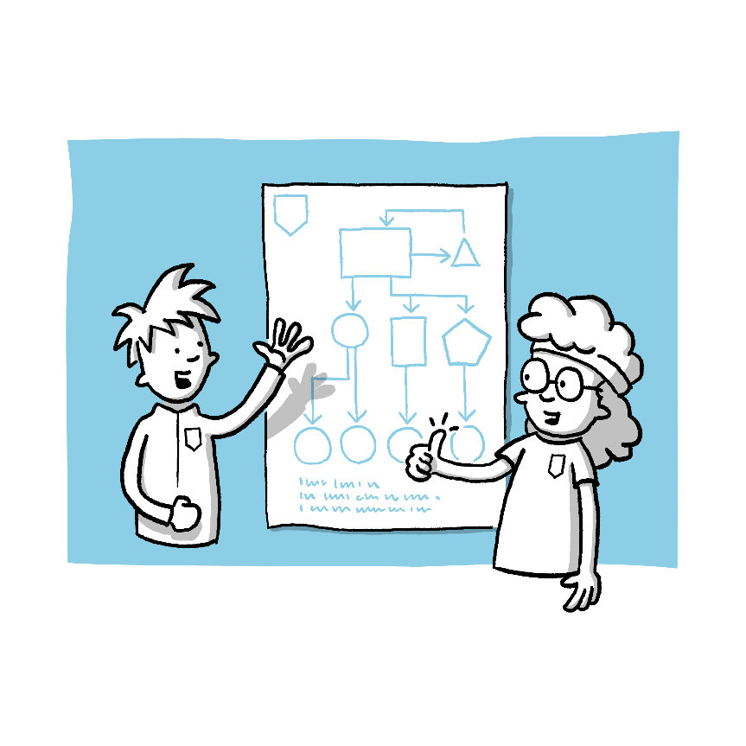
Take-Home Message
Notes:
Recap today's workshop and the reflection tasks with the participants.
Participants can then formulate an individual take-home message based on the findings of today's reflection.
Depending on the group dynamics, you can decide whether the individual Take Home messages should be shared with the group or not.

Slide 20
Further training opportunities for coaches:
Further training courses organised by the German state sports associations or professional associations
E-learning platform on protection concepts: https://engagement-schutzkonzepte.elearning-kinderschutz.de/
Training videos of the Deutschen Sportjugend: https://safesport.dosb.de/schulungsvideos
English-speaking: "Safeguarding Course" of the IOC https://olympics.com/athlete365/courses/safeguarding/
In-house training courses by external speakers, e.g. sports psychologists
Notes:
Please adjust the training opportunities regularly and check that the links are up to date.

Slide 21

Possible offers of help
Contact persons in the organisation
Name local contact points/cooperation partners
Name contact points of the association/state sports association or similar
SafeSport point of contact:
  https://www.ansprechstelle-safe-sport.de
  Phone: +49 (0)800 11 222 00
Nummer gegen Kummer:
  https://www.nummergegenkummer.de
  Phone: 116 111
Help portal for sexual abuse:
  https://www.hilfe-portal-missbrauch.de/en/home
  Phone: +49 (0)8002255530
Notes:
Finally, the participants should have the opportunity to find out about further offers of help.
Please adapt this slide to the respective sports club and region.
Please note that the contact points and their availability may change in the meantime, so please check the links and telephone numbers provided.

Slide 22
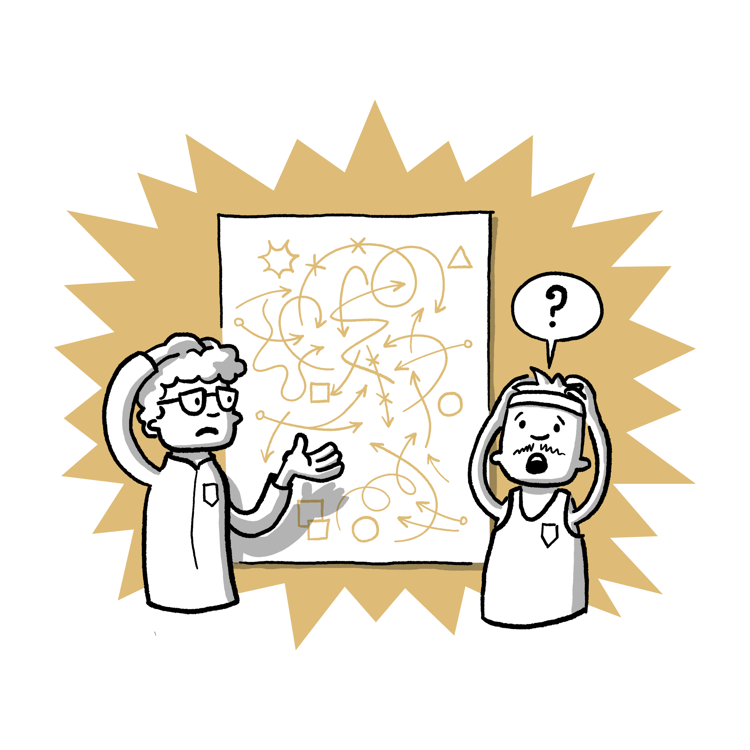
Thank you very much for your attention!
Are there any questions?
Notes:
Give the participants another opportunity to ask questions.
You can then end the workshop by thanking everyone for their participation and saying goodbye.
Please stay in the room for a while after the workshop so that participants have the opportunity to ask individual questions

Slide 23
Sources
Appleton, P. R., & Duda, J. (2016). Examining the interactive effects of coach-created empowering and disempowering climate dimensions on athletes' health and functioning. Psychology of Sport and Exercise, 26, 61–70. https://doi.org/10.1016/j.psychsport.2016.06.007.
Duda, J. (2013). The conceptual and empirical foundations of Empowering CoachingTM: Setting the stage for the PAPA project. International Journal of Sport and Exercise Psychology, 11(4), 311–318. https://doi.org/10.1080/1612197X.2013.839414.
Duda, J., & Appleton, P. R. (2016). Empowering and Disempowering Coaching Climates: Conceptualisation, Measurement Considerations, and Intervention Implications. In M. Raab, P. Wylleman, R. Seiler, A.-M. Elbe, & A. Hatzigeorgiadis (Eds.), Sport and Exercise Psychology Research (pp. 373–388). Academic Press. https://doi.org/10.1016/B978-0-12-803634-1.00017-0.
Epstein, J. (1988). Effective schools or effective students? Dealing with diversity. In R. Haskins & B. MacRae (Eds.), Policies for America's public schools (pp. 89–126). Ablex.
Epstein, J. (1989). Family structures and student motivation: A developmental perspective. In C. Ames & R. Ames (Eds.), Research on motivation in education (pp. 259–295). Academic Press.
Greither, T., & Ohlert, J. (2023). Empowering and disempowering climate and experiences of psychological violence in artistic gymnastics. German Journal of Exercise and Sport Research. https://doi.org/10.1007/s12662-023-00886-7.
McMahon, S., & Banyard, V. L. (2012). When Can I Help? A Conceptual Framework for the Prevention of Sexual Violence Through Bystander Intervention. Trauma, Violence, & Abuse, 13(1), 3–14. https://doi.org/10.1177/1524838011426015.
Ohlert, J., Schmitz, H., Schäfer-Pels, A., & Allroggen, M. (2022). An Empowering Climate as a Protective Factor against Sexual Violence in Sport? Social Sciences, 11(8), 330. https://doi.org/10.3390/socsci11080330.
Notes:
Literature

Slide 24
Citation reference
If you would like to cite this workshop concept, please use the following citation reference:
Greither, T., Schmitz H., Sulprizio, M., Allroggen, M., & Ohlert, J. (2025). Reflection on the organisation of my training climate [workshop concept]. German Sport University Cologne and University Hospital Ulm.

Slide 25
Imprint
Publishers
German Sport University Cologne
Psychological Institute
Dept. of Health & Social Psychology
Am Sportpark Müngersdorf 6
50933 Cologne, Germany
www.dshs-koeln.de/psychologisches-institut/
University Hospital Ulm
Clinic for Child and Adolescent Psychiatry, Psychosomatics, and Psychotherapy
Research Group Violence, Developmental Psychopathology, and Forensics
Steinhövelstraße 5
89075 Ulm, Germany
https://www.uniklinik-ulm.de/kinder-und-jugendpsychiatrie-psychosomatik-und-psychotherapie.html
Available from
"SafeClubs" project - transfer concepts for the prevention and intervention of sexual violence in sports clubs
Collaboration management: Dr. Jeannine Ohlert (German Sport University Cologne)
Sub-project management: Dr. Jeannine Ohlert, Univ. Prof. Dr. Bettina Rulofs (both German Sport University Cologne), Prof. Dr. med. Marc Allroggen,
Dr. Alina Schäfer-Pels (both University Hospital Ulm)
Collaboration coordination: Marion Sulprizio (German Sport University Cologne)
Collaboration: Helena Schmitz, Annika Söllinger, Janna Kerkow, Sina Kiekbusch, Paula Edler (all German Sport University Cologne), Teresa Greither
(University Hospital Ulm)
https://safe-clubs.de

Slide 26
Imprint
Authors
Teresa Greither^{1,2}, Helena Schmitz³, Marion Sulprizio³, Marc Allroggen^{1,2} & Jeannine Ohlert^{3,4}
¹ University Hospital Ulm, Clinic for Child and Adolescent Psychiatry, Psychosomatics, and Psychotherapy
² German Center for Mental Health (DZPG), partner site Ulm
³ Psychological Institute, German Sport University Cologne
⁴ German Research Centre of Elite Sport (momentum), Cologne
With contributions from Janna Kerkow, Sina Kiekbusch, Vivian Gast (all German Sport University Cologne)
Image credit Marcel Jansen, Instagram: @mrcl_cartoons
Funding Acknowledgment The project underlying this report was funded by the Federal Ministry of Education and Research under the grant number 01SR2106A. The responsibility for the content of this publication lies with the authors.
Publication Date: January 2025 – Digital Version
Copyright © German Sport University Cologne and University Hospital Ulm, 2025
All Rights Reserved Without the express permission of the University Hospital Ulm and the German Sport University Cologne, it is not permitted to reproduce the content of this presentation or parts thereof by photographic, printing, or digital means for commercial purposes.
Texts, tables, and graphics may gladly be used for voluntary work, including in sports federations and clubs.

