Slide 1
Gamechanger
How coaches create a training environment that motivates and strengthens athletes
Workshop concept for coaches
Notes:
Welcoming the participants
Target group: Coaches with basic knowledge of interpersonal violence in sport (e.g. participation in the "Safe Space" workshop for adults, or through the coach education programme)
Describe the contents/objectives of the workshop
Improve protection against interpersonal violence in sports clubs
Possible courses of action for coaches towards a culture of observation
Establishing a positive and conducive training environment
Concrete implementation options in everyday training
Optional: Round of introductions, have name badges set up
Optional: Ask for expectations of the workshop, e.g. with the help of moderation cards

Slide 2
((Delete if necessary: Personal introduction))
Name
Profession
(insert further background info if desired...)
If applicable. Contact possibility
Notes:
Introduction of the speaker by name
You can introduce yourself using the PowerPoint slide or leave it at an oral presentation (without slide notes)
Delete slide if necessary

Slide 3
Workshop programme
Duration 120 min
Coaches' perspectives on the topic of protection from violence
Basics of the empowering coaching climate
Implementation in training practice based on the empowerment areas
Take-Home Message
Notes:
Describe the course of the workshop

Slide 4
Notes for workshop participants
Sensitive topic of violence:
Compliance with general rules of dialogue, e.g. respectful atmosphere, respecting the personal experiences of others
Participants may leave the room if necessary
Opportunity for discussion after the workshop
Offers of assistance:
If participants need support after the workshop, please get in touch with the presenter, the contact person at your organisation or a specialised counselling centre
Suitable counselling services:
  SafeSport contact point: https://www.ansprechstelle-safe-sport.de
  Nummer gegen Kummer: https://www.nummergegenkummer.de
  Help portal for sexual abuse: https://www.hilfe-portal-missbrauch.de/
Notes:
Notes for participants:
The content of the workshop can be potentially stressful, as it deals with sensitive topics such as sexualised violence.
This workshop is intended to provide a safe space: Other people's stories should be respected and not judged, and should not be publicised.
Allow participants to leave the room or take a break.
Please offer the opportunity for a discussion after the workshop.
Point out available offers of help:
If possible, also name a suitable local contact centre/contact person.
Please customise the fields marked in yellow.

Slide 5
Perspectives from coaches
Challenges and opportunities around protection against violence
Notes:
At the beginning, a reflection on the topic of protection against violence from the perspective of coaches should be conducted by means of a (small) group discussion, e.g. with the people sitting next to them.
Possible reflection questions:
What aspects of violence prevention are you particularly concerned with as coaches?
What challenges do coaches face in terms of protection from violence?
What opportunities do you see to change your training in order to improve protection against violence?
How do you see your own role as a coach (in terms of protection from violence)?
Background information
Important contents of the kick-off workshop were
Children's rights, criminal law limits
Forms and frequency of interpersonal violence
Consequences of interpersonal violence
Options for action for adults (bystanders)
If the participants have no prior knowledge of the topic, it is advisable to introduce basic aspects with the help of some slides from the "Safe Space" workshop.

Slide 6
Special features in sport
Close relationships, often family structures
Dependency relationships and hierarchies
Gender relations
Body-centredness
(Rulofs, Wahnschaffe-Waldhoff, et al., 2022)
Notes:
Coaches have a special responsibility to protect children from violence. They operate in a special environment because sports clubs often...
Close relationships, often family structures:
Sports clubs are leisure centres
Friendships develop
High level of voluntary commitment
Trust between coaches, parents and athletes
Partially entrenched structures and traditions
Dependency relationships and hierarchies
Between coaches and club management:
Training requirements or performance level
Promotion/restriction of (voluntary) commitment
Between coaches and athletes:
Athletes are dependent on the knowledge of their coaches
Power to decide on inclusion in training groups, line-up for matches/competitions
Generally large differences in age and knowledge
Between athletes
Differences in performance
Social hierarchies, e.g. differences in age or development, status within the group
Negative group dynamics
Gender relations
Subdivision men/women's sport
Women rarely work as coaches for all-male sports groups; the reverse is more common
Gender-specific expectations such as the development of certain physical characteristics (strength, flexibility, etc.)
Body-centredness
Focus on developing physical skills
Strict dress code in some cases
Physical contact during assistance or partner exercises
The emergence of boundary violations and interpersonal violence can be favoured by a lack of consideration of these particularities.

Slide 7
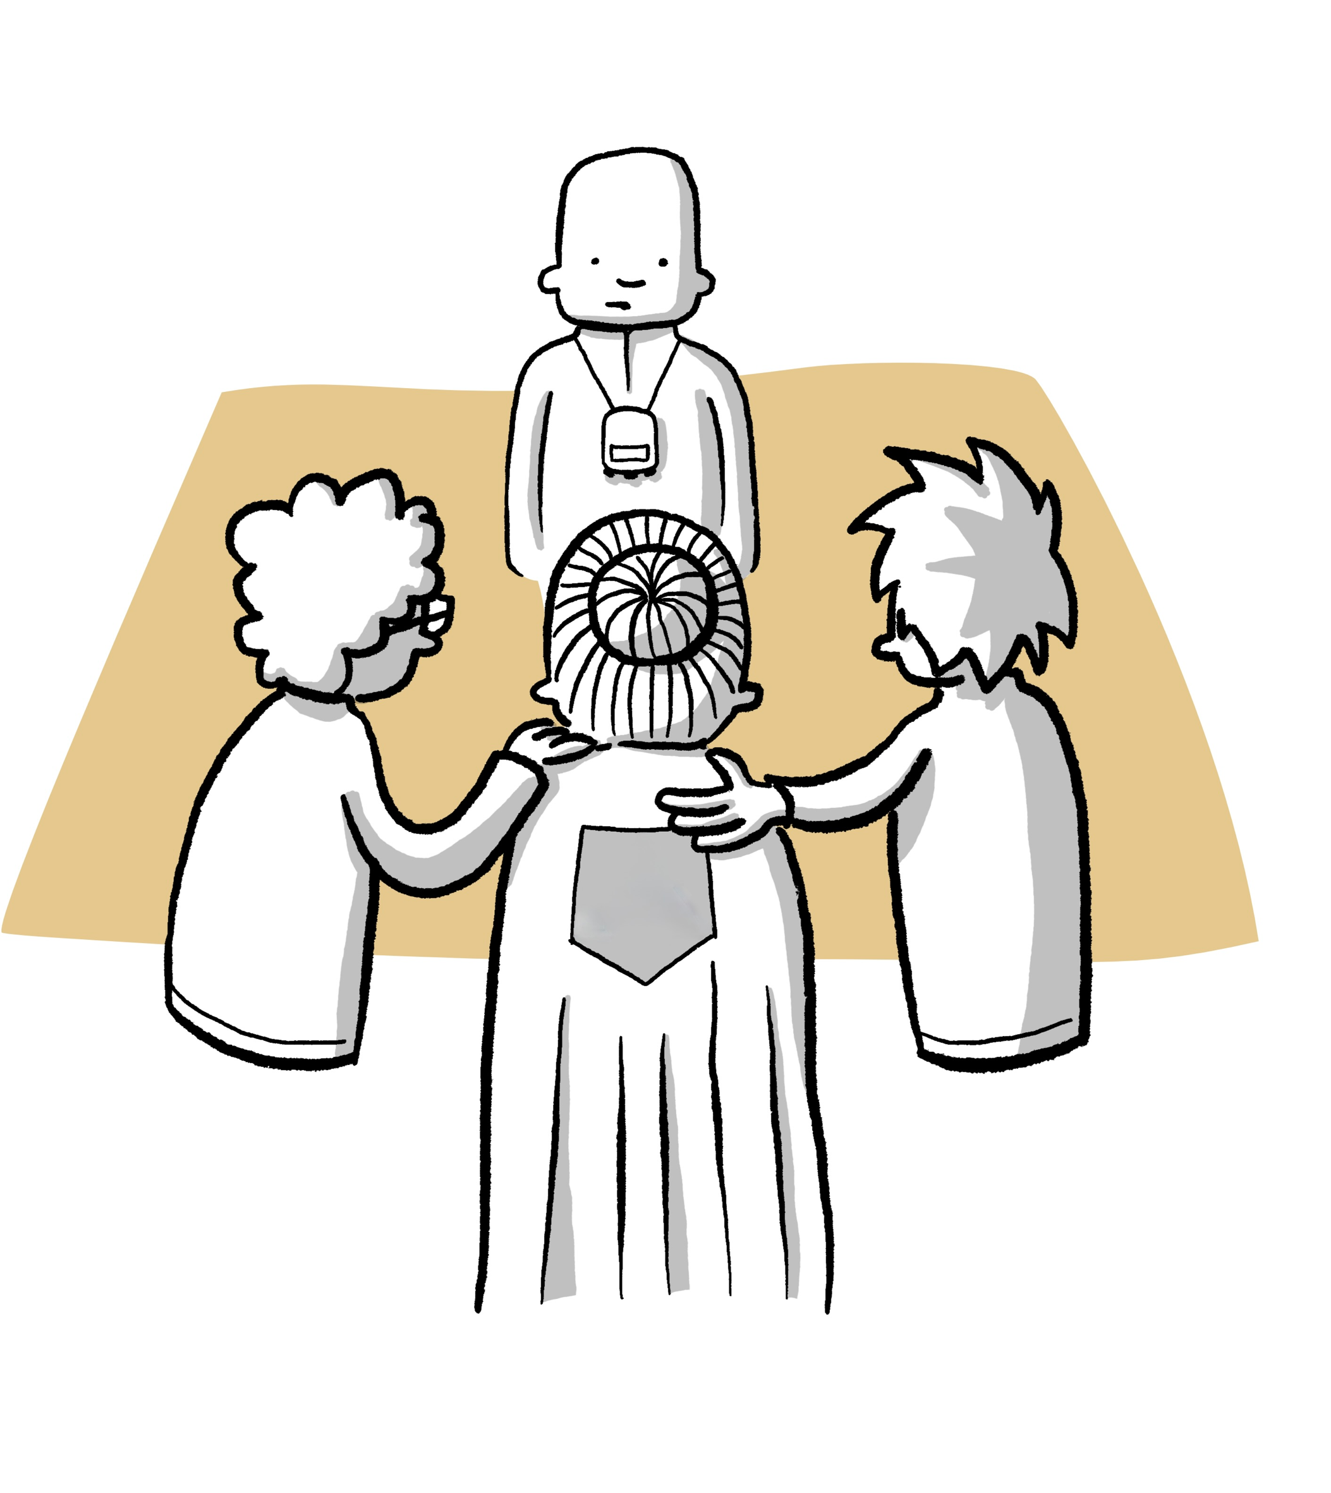
Challenges for coaches
Violence (psychological, physical, sexualised) in sport takes place
  In your own sports group (athletes among themselves)
  Observation of violence by other persons/groups
  As a person of trust for children/young people (experience of violence at home)
Additional danger of false suspicions
(Rulofs, Gerlach et al., 2022)
Notes:
Here you can address the aspects mentioned in the reflection at the beginning and name further challenges.
Violence in sport takes place, even in leisure and recreational sport
Very few incidents have been officially reported to date
However, many people have already observed boundary violations in a sporting context at some point
The incidents take place in different contexts:
In your own group, e.g. also among the athletes themselves
As a coach, you observe an incident, e.g. in another team or at a competition
Children or young people report experiences of violence that they have had in a different context: Coach as a person of trust
Danger of false suspicions:
These can arise if the coach does not have sufficient confidence to act
Too often no clear rules within the club or within the training group

Slide 8
Options for action as a coach
Prevention
For your own training group:
Rules of behaviour negotiate together with the athletes and follow them consistently (respect individual personal boundaries)
Also communicating rules for yourself and stick to them - protects against false suspicions
"Complaints management" establish
Empowering climate in your own sports group
Intervention
For observations:
Get in touch with contact person for child protection in the club/association/state sports association
When athletes confide in each other:
Believe, seek support from contact persons/counselling centres
(Bartsch & Rulofs, 2020)
Notes:
Several measures should be implemented to ensure protection from violence and to protect oneself from false suspicions.
Emphasise the role model function of coaches, e.g. standards of conduct for coaches: Making transparent decisions, establishing a culture of error
To avoid violence/bullying between athletes: Clear expectations, rules and consequences.
Complaints management: Create guidelines for parents and athletes, possibly use anonymous feedback option, document implementation
Utilise as many positive training strategies as possible:
Avoidance of potentially boundary-violating strategies
Consideration of children's rights
Orientation towards an empowering coaching climate
You can also refer to proactive bystander behaviour (see the "Safe Space Sports Club" workshop and the following slide)
Use contact persons: They provide support if there are uncertainties and can provide competent assistance in the event of suspicions
Coaches are not responsible for investigating suspected cases: This requires specialised personnel. Here you can find further information on the protection concept, code of honour or code of conduct of the respective association.

Slide 9
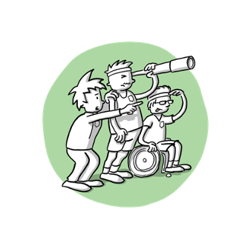
Reacting correctly as a bystander
 | Proactive Independent of incidents | Reactive In response to an incident
Positive | Further education and training Be a good role model Consideration of children's rights in sport, e.g. allowing young athletes to have a say | Intervene to put an end to the incident Standing by those affected Inform parents Involve a contact person
Negative | Trivialisation of violence Promotion of (gender) discrimination Disregard for the opinions and rights of the athletes | Instigating or condoning the behaviour Taking part yourself Not giving any credence Playing down what happened
(McMahon & Banyard, 2012)
Notes:
Optional:
Repetition (or presentation) of the "bystander behaviour"
Differentiation between positive (top line) and negative (bottom line)
As well as between reactive (close to the event) and proactive (not in connection with an event).

Slide 10
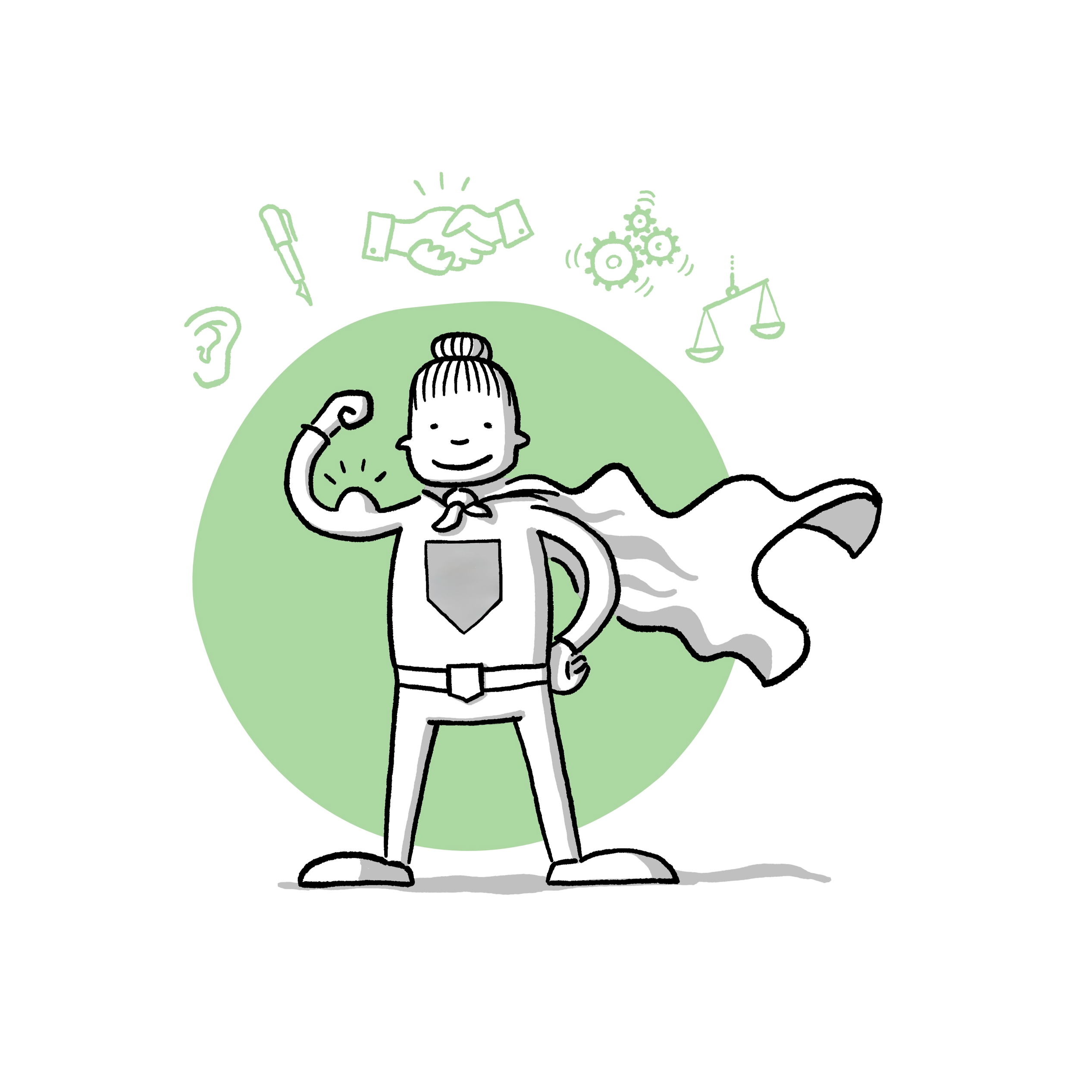
Empowering coaching climate
How coaches create a training environment in which athletes are sustainably empowered
Notes:
Appropriate values and attitudes are key to preventing interpersonal violence. A respectful & appreciative approach serves as the basis. This becomes visible in our daily dealings with each other, e.g. in the training atmosphere:
Empowering coaching climate
Theoretically sound and evidence-based framework concept for coach training
The aim is to promote a healthy socio-psychological environment in sports groups
Intrinsic motivation, enjoyment and commitment are emphasised
The focus is on the behaviour of coaches because…
They have a direct influence on behaviour in the training group
They spend most of their time with the athletes
Target: Learn evidence-based and effective strategies for successful empowering coaching.

Slide 11
Definition of empowerment
"Encourage other people in their decisions, boundaries, their own personality, strengths and rights"
Notes:
Reference to children's rights possible (see "Safe Space Sports Club" workshop):
Empowerment is in line with the best interests of the child
For example, children and young people have the right to individual development, have a say in decision-making and should be supported positively as they grow up
Here (if there is time) a short joint reflection can take place, e.g. whether the coaches have an idea of how they already take these things into account in their training.

Slide 12
Empowering coaching climate
Promoting autonomy
Social support
Feeling of competence
Task orientation
3 basic psychological needs
Goal orientation
(Duda & Appleton, 2016; Duda, 2013)
Notes:
At this point, please briefly explain the theoretical background of the empowering coaching climate. Make sure you use simple language with few technical terms. If necessary, you can explain the components with the help of sport-specific examples.
The empowering coaching climate combines two socio-psychological theories:
Self-determination theory
Achievement goal theory
Four components make up the empowering coaching climate. The three basic psychological needs stem from self-determination theory:
Autonomy and its promotion: To be able to control and determine one's own actions (within a suitable framework); to be free from restriction, paternalism and encroachment.
Social support: Experience recognition, belonging and solidarity in a group
Feeling of competence: Wanting to perceive oneself as competent; describes the desire of people to make progress and expand their own skills.
The task-orientation component stems from the "Achievement-Goal Theory" (goal-orientation):
Task-orientated goals focus on the individual improvement and development of skills and abilities.
(In contrast to this is the performance orientation: The comparison between athletes serves as a learning benchmark instead of individual improvement)
If all four components are fulfilled/observed, the athletes perceive the training as empowering.

Slide 13
Disempowering climate
Empowering
climate
vs.
Notes:
There is also a "downside" to the climate of empowerment. Certain actions and strategies do not empower athletes, but rather have the opposite effect: They weaken the fulfilment of the three basic needs (competence, social support and autonomy) and primarily use a performance orientation (the comparison/competition between athletes) to evaluate success.
Important: This so-called "disempowering climate" is not only the opposite of the empowering climate. It can also occur simultaneously with empowering behaviours. For example, you can set both performance- and task-orientated targets.
Research shows that actions that weaken empowerment tend to have negative consequences, such as less motivation for sport. It is therefore important to utilise empowering strategies as much as possible in order to optimally support the athletes.
Optional:
Brainstorm examples of strategies that weaken empowerment and where these could be replaced by empowering strategies.
Group discussion: Does training work at all if only empowering methods are used?
The aim is to recognise that in many cases there are both strengthening and weakening aspects at the same time.

Slide 14
Disempowering climate
Consequences
Excessive control
Not accepting other opinions
Punishment for mistakes, threat of punishment
Ignoring or shouting at them after poor performance
Treating athletes unequally (favouring the best)
Constant comparisons with each other, encouraging competition
Getting involved in life outside of sport
Reduced motivation
Greater fear
More thoughts about your own performance
Belief that above all ability (unchangeable) determines performance
Increased conflicts among athletes
Increased search for excuses for poor performance
Leaving the sport
Leads to
(Appleton & Duda, 2016)
Notes:
In the disempowering coaching climate, it is quite clear that this can lead to boundary violations and psychological violence.
In a training climate that weakens empowerment, protection against violence and the promotion of the child's welfare are not the top priorities.
A climate that weakens empowerment has negative consequences for athletes.
This also indirectly affects athletic performance (e.g. less motivation, anxiety, dropping out of sport).

Slide 15
Empowerment enhancing climate
Consequences
Take care of all athletes equally, let everyone make a contribution
Involving athletes in decisions
Performance comparison with your own previous performance
Honour improvement, mistakes are part of learning
What counts is effort and willpower, not objective performance
Communication with athletes at eye level
Promoting mutual cooperation
Stronger motivation and greater effort
Fun, satisfaction and positive emotions
Perceived (subjective) competence
Useful strategies for dealing with stress
Positive relationships, fairness and less aggression among athletes
Better performance in competition (subjective and first indications of objective performance)
Leads to
(Appleton & Duda, 2016)
Notes:
Empowering strategies, on the other hand, clearly serve to promote the child's well-being
As the consequences clearly show, this is accompanied by many positive correlations
By implementing an empowering coaching climate the coach ensures that the entire group can benefit from the positive effects of sport.

Slide 16
Here you can embed the video on the Empowerment training climate. The video is only available in German and can be downloaded from the website.
Notes:
Video on the empowerment coaching climate:
Coaches’ behaviours such as
Decide everything alone
Do not allow other opinions
Penalise mistakes
... describe a controlling, “me-centred" climate. This leads to a weakening of the athletes' empowerment.
Alternatively, coaches can use empowering behaviours:
These are categorised in a practical way using six categories (explanation on the following slides).
These areas can be used to create a climate that fosters empowerment.
This promotes the fulfilment of basic psychological needs. The fun and motivation of the athletes increases.
The video is in German, thus please consider removing or exchanging the video.

Slide 17
Empowerment areas
Practical implementation of an empowering climate in training
Notes:
Transition to the six areas of empowerment ("target" model) from the video:
Six categories of how empowering training content can be implemented
Can be used as a "checklist" by coaches
Target: Consciously adapt and regulate training to strengthen empowerment

Slide 18
Empowerment areas
Task
Autonomy
Recognition/
Perception
Grouping
Evaluation
Time
Steps to the introduction of the empowering climate:
Promotion of intrinsic motivation and therefore performance
Confidence in action for coaches
Offers at the same time protection from violence and false suspicions
(Ohlert et al., 2022;
Greither & Ohlert, 2023)
(Epstein, 1988, 1989)
Notes:
There are various areas that a coach should consider during training in order to promote the empowerment of their charges:
Task
Autonomy
Recognition/perception
Group composition
Valuation
Time
Based on these six areas, the empowering climate can be implemented step by step in training.
A training climate that is orientated towards the six areas of empowerment promotes intrinsic motivation and the athletes enjoy their performance.
At the same time, it offers protection against violence and false suspicions:
Boundary-violating behaviour can be better avoided
Coaches fulfil their role model function
Children's rights are taken into account.

Slide 19
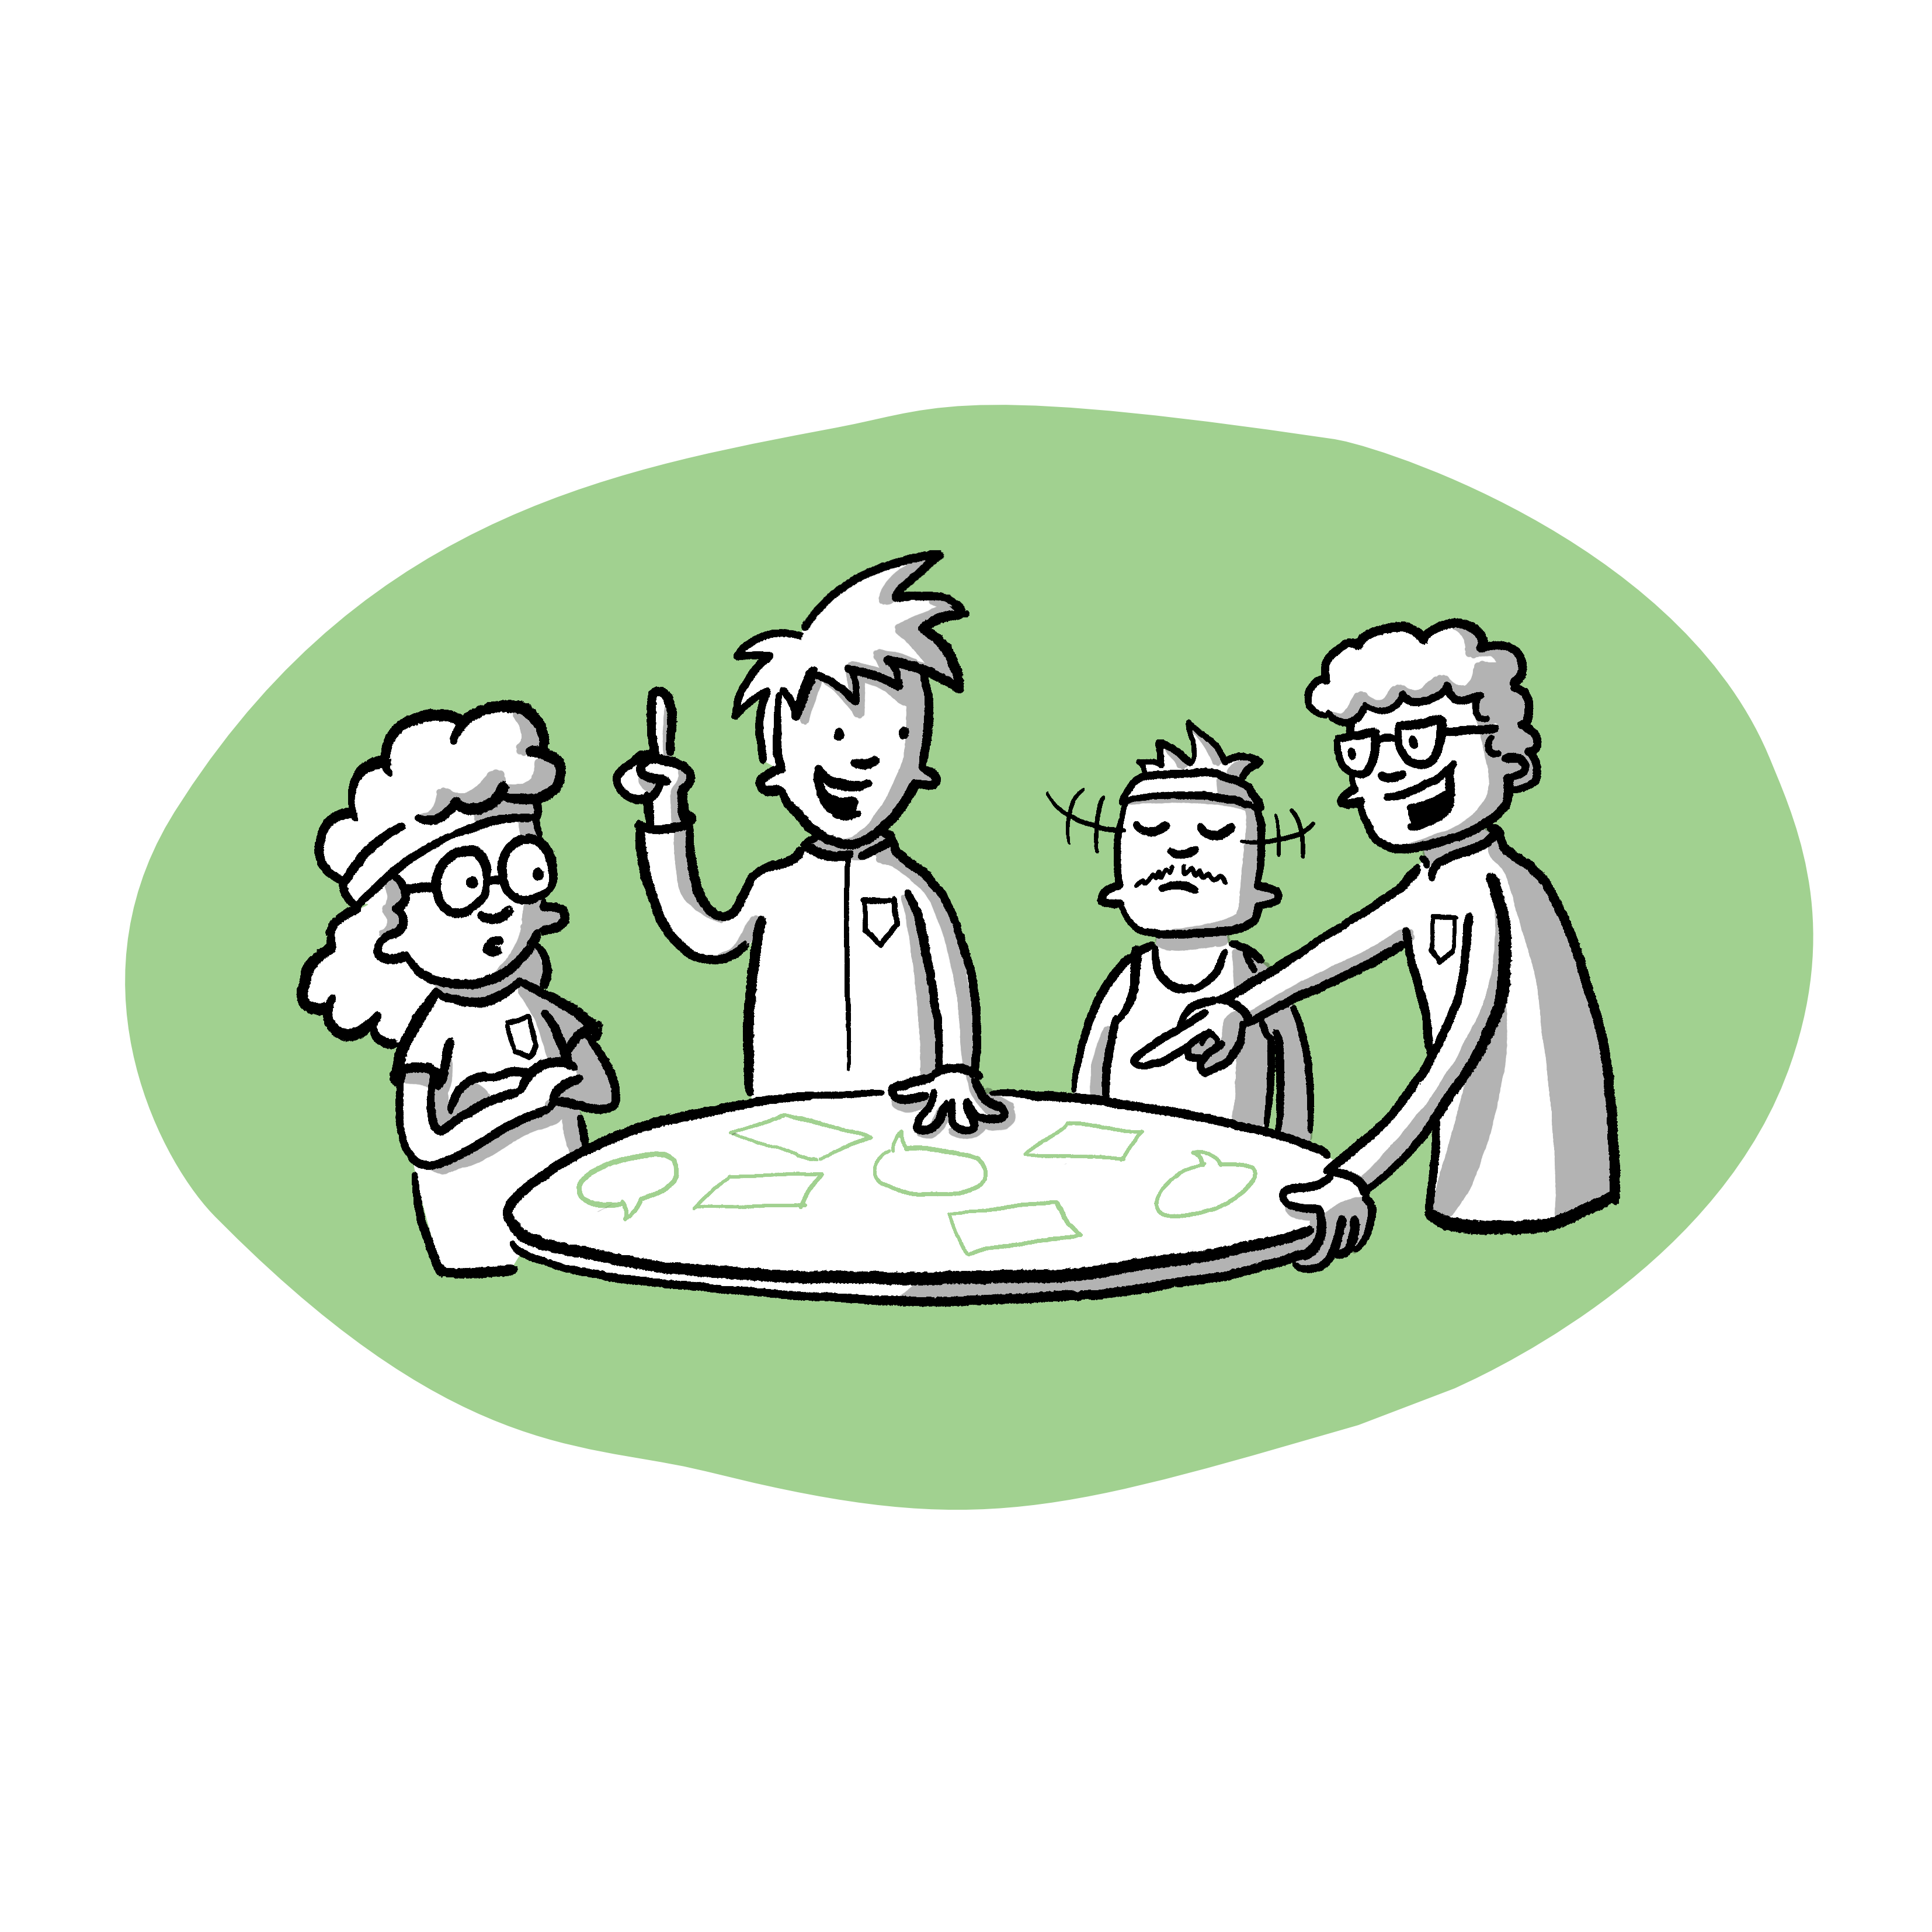
Group work
Which behaviours are disempowering and which are empowering within the various empowerment areas?
Notes:
First, briefly introduce the task:
The individual areas of empowerment should be discussed in small groups as part of a brainstorming session.
Which behaviours are disempowering and which are empowerment-strengthening in the respective areas?
Firstly, use the following slide to work on the example time together and explain the instructions.

Slide 20
TIME
Disempowering
Empowering
Total exercise time limited
Practice time identical for all
Time distribution varies greatly for the individual athletes
Individual time to practise
Spend the same amount of time with all athletes
Notes:
You are welcome to find sport-specific, suitable examples for the individual points.
Weakening:
Exercise time limited overall: The coach talks a lot, or you spend (too) much time setting things up
Practice time identical for all: It is not possible to work on a particular exercise/sequence independently for a longer period of time.
Time distribution for the individual athletes varies greatly: Some are always allowed to play the entire training game, others are only allowed to play once at the end.
Strengthening:
Individual time to practise: The athletes can also practise a little longer at a particular station.
Spend the same amount of time with all athletes: The coach ensures that all athletes receive feedback as frequently as possible.
The examples already make it clear that the context is important for categorising empowerment strengthening/weakening. Encourage constructive dialogue at this point. As described above (slide notes to slide 13), weakening and strengthening aspects can occur at the same time.

Slide 21
Group work
Developed empowering and disempowering strategies for your empowerment area:
How can the training be adapted with regard to this area so that it enhances empowerment?
What weakens empowerment?
What would be practical examples?
Task for the small groups:
General discussion of the respective dimension
Formulation of a "checklist" for training sessions in order to act in the most empowering way possible
Task
Autonomy
Recognition/
Perception
Grouping
Evaluation
Time
Notes:
Participants should find examples for the dimension assigned to them. Divide into small groups:
Experience has shown that a group should consist of approx. 3-4 people.
If 15 or more people are present, 5 groups are possible, with each group working on one area.
If there are fewer people, the groups can work on two (or more) dimensions.
Alternatively, the group work can be organised at different "theme tables" and organised more freely
Note down the five dimensions to be worked on on moderation cards (see also additional material) and distribute them.
One group at a time:
Task
Autonomy
Recognition/perception
Group composition
Evaluation
After the group work phase, the results are collated and saved:
Now distribute the handouts on the "empowerment areas"
Have the individual groups present their results one after the other
Compare the results using slides 22-26 and the handout
Additional ideas/notes can be noted on the handouts
If necessary, note down additional ideas on moderation cards/flipchart/whiteboard

Slide 22
Recognition/
Perception
Disempowering
Empowering
Comparison between different athletes (individual skills and abilities), individually or publicly
Comparison between different groups (collective ability), individually or publicly
Unequal perception/ consideration of individual athletes
Unequal conditions for rewards
Individual commitment and skill development are recognised through personal or public feedback
Willingness to make an effort is recognised
Equal perception/consideration of all athletes
Equal reward conditions for all
Notes:
Nutzen Sie diese Folie zur Ergebnissicherung der Gruppenarbeitsphasen.

Slide 23
Task
Disempowering
Empowering
Common/similar tasks
Goals in competition form
Identical goals for all
Differentiated tasks (according to individual ability), co-operation
Encourage individual goals, own objectives
Present the learning process as meaningful
Notes:
Nutzen Sie diese Folie zur Ergebnissicherung der Gruppenarbeitsphasen.

Slide 24
Autonomy
Disempowering
Empowering
Coach makes all decisions themselves
Responsibility lies solely with the coach
Athletes are involved in the decision-making process
Orientation towards the level of development of the athletes
Inclusion of experienced athletes in the training concept
Notes:
Nutzen Sie diese Folie zur Ergebnissicherung der Gruppenarbeitsphasen.

Slide 25
Grouping
Disempowering
Empowering
Entire team
Homogeneous groups
Always the same groups
Strong hierarchy in the group
Emphasise competition
Mixed / heterogeneous groups
Individual work
Flat hierarchy in the group
Promoting social cohesion (cooperation)
Notes:
Nutzen Sie diese Folie zur Ergebnissicherung der Gruppenarbeitsphasen.

Slide 26
EValuation
Disempowering
Empowering
Comparison of different athletes as feedback
Public humiliation or punishment for mistakes
Different rules for athletes
No consistent enforcement of rules
Individual feedback on skills and abilities
Individual feedback on progress and development
Same rules for all
Consistent adherence to the rules
Promote self-evaluation
Notes:
Nutzen Sie diese Folie zur Ergebnissicherung der Gruppenarbeitsphasen.

Slide 27
TIME
Disempowering
Empowering
Total exercise time limited
Practice time identical for all
Time distribution varies greatly for the individual athletes
Individual time to practise
Spend the same amount of time with all athletes
Notes:
Note: Time was already introduced at the beginning, but you can also revisit this slide a second time for repetition.

Slide 28
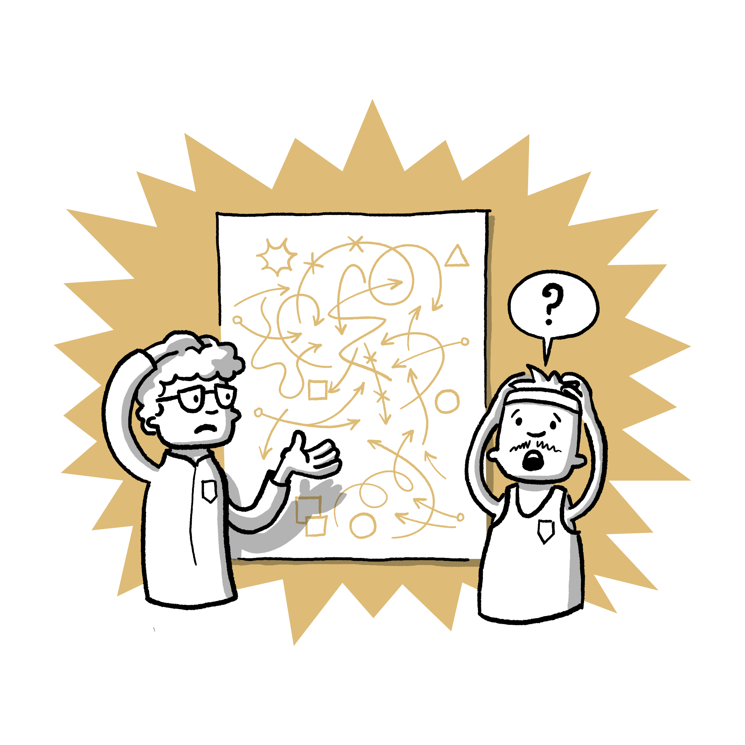
Reflection
Discuss your own behaviour in training based on the following questions:
What am I already doing?
Where do I see potential for further development?
What is my goal for the coming weeks/months?
Notes:
In the final exercise, the coaches should reflect on their own behaviour and draw up an action plan for the upcoming training sessions.
Form small groups (2-3 people) and select 2-3 questions:
What am I already doing?
Where do I see potential for further development?
Why am I not yet implementing various points? Where do I prioritise my needs over those of my athletes?
Why create an empowering training environment? How does it benefit me as a person, me as a coach and my athletes?
How can I use the coming weeks/months?
What am I going to do?
What is my objective?
What obstacles could stand in the way of achieving this goal? How can I deal with such an obstacle?

Slide 29
Empowerment exercise collection
(HERE LINK & EMBEDD QR Code)
With the help of the "Empowerment Exercise Collection", coaches can implement the empowering coaching climate independently.
Notes:
At this point, mention that there is a collection of empowerment exercises for coaches that also emerged from the SafeClubs project.
The QR code takes the coaches directly to the website.
It can help to independently implement an empowering coaching climate in the training group.
The empowement exercise collection is only available in German, therefore consider removing this slide.

Slide 30
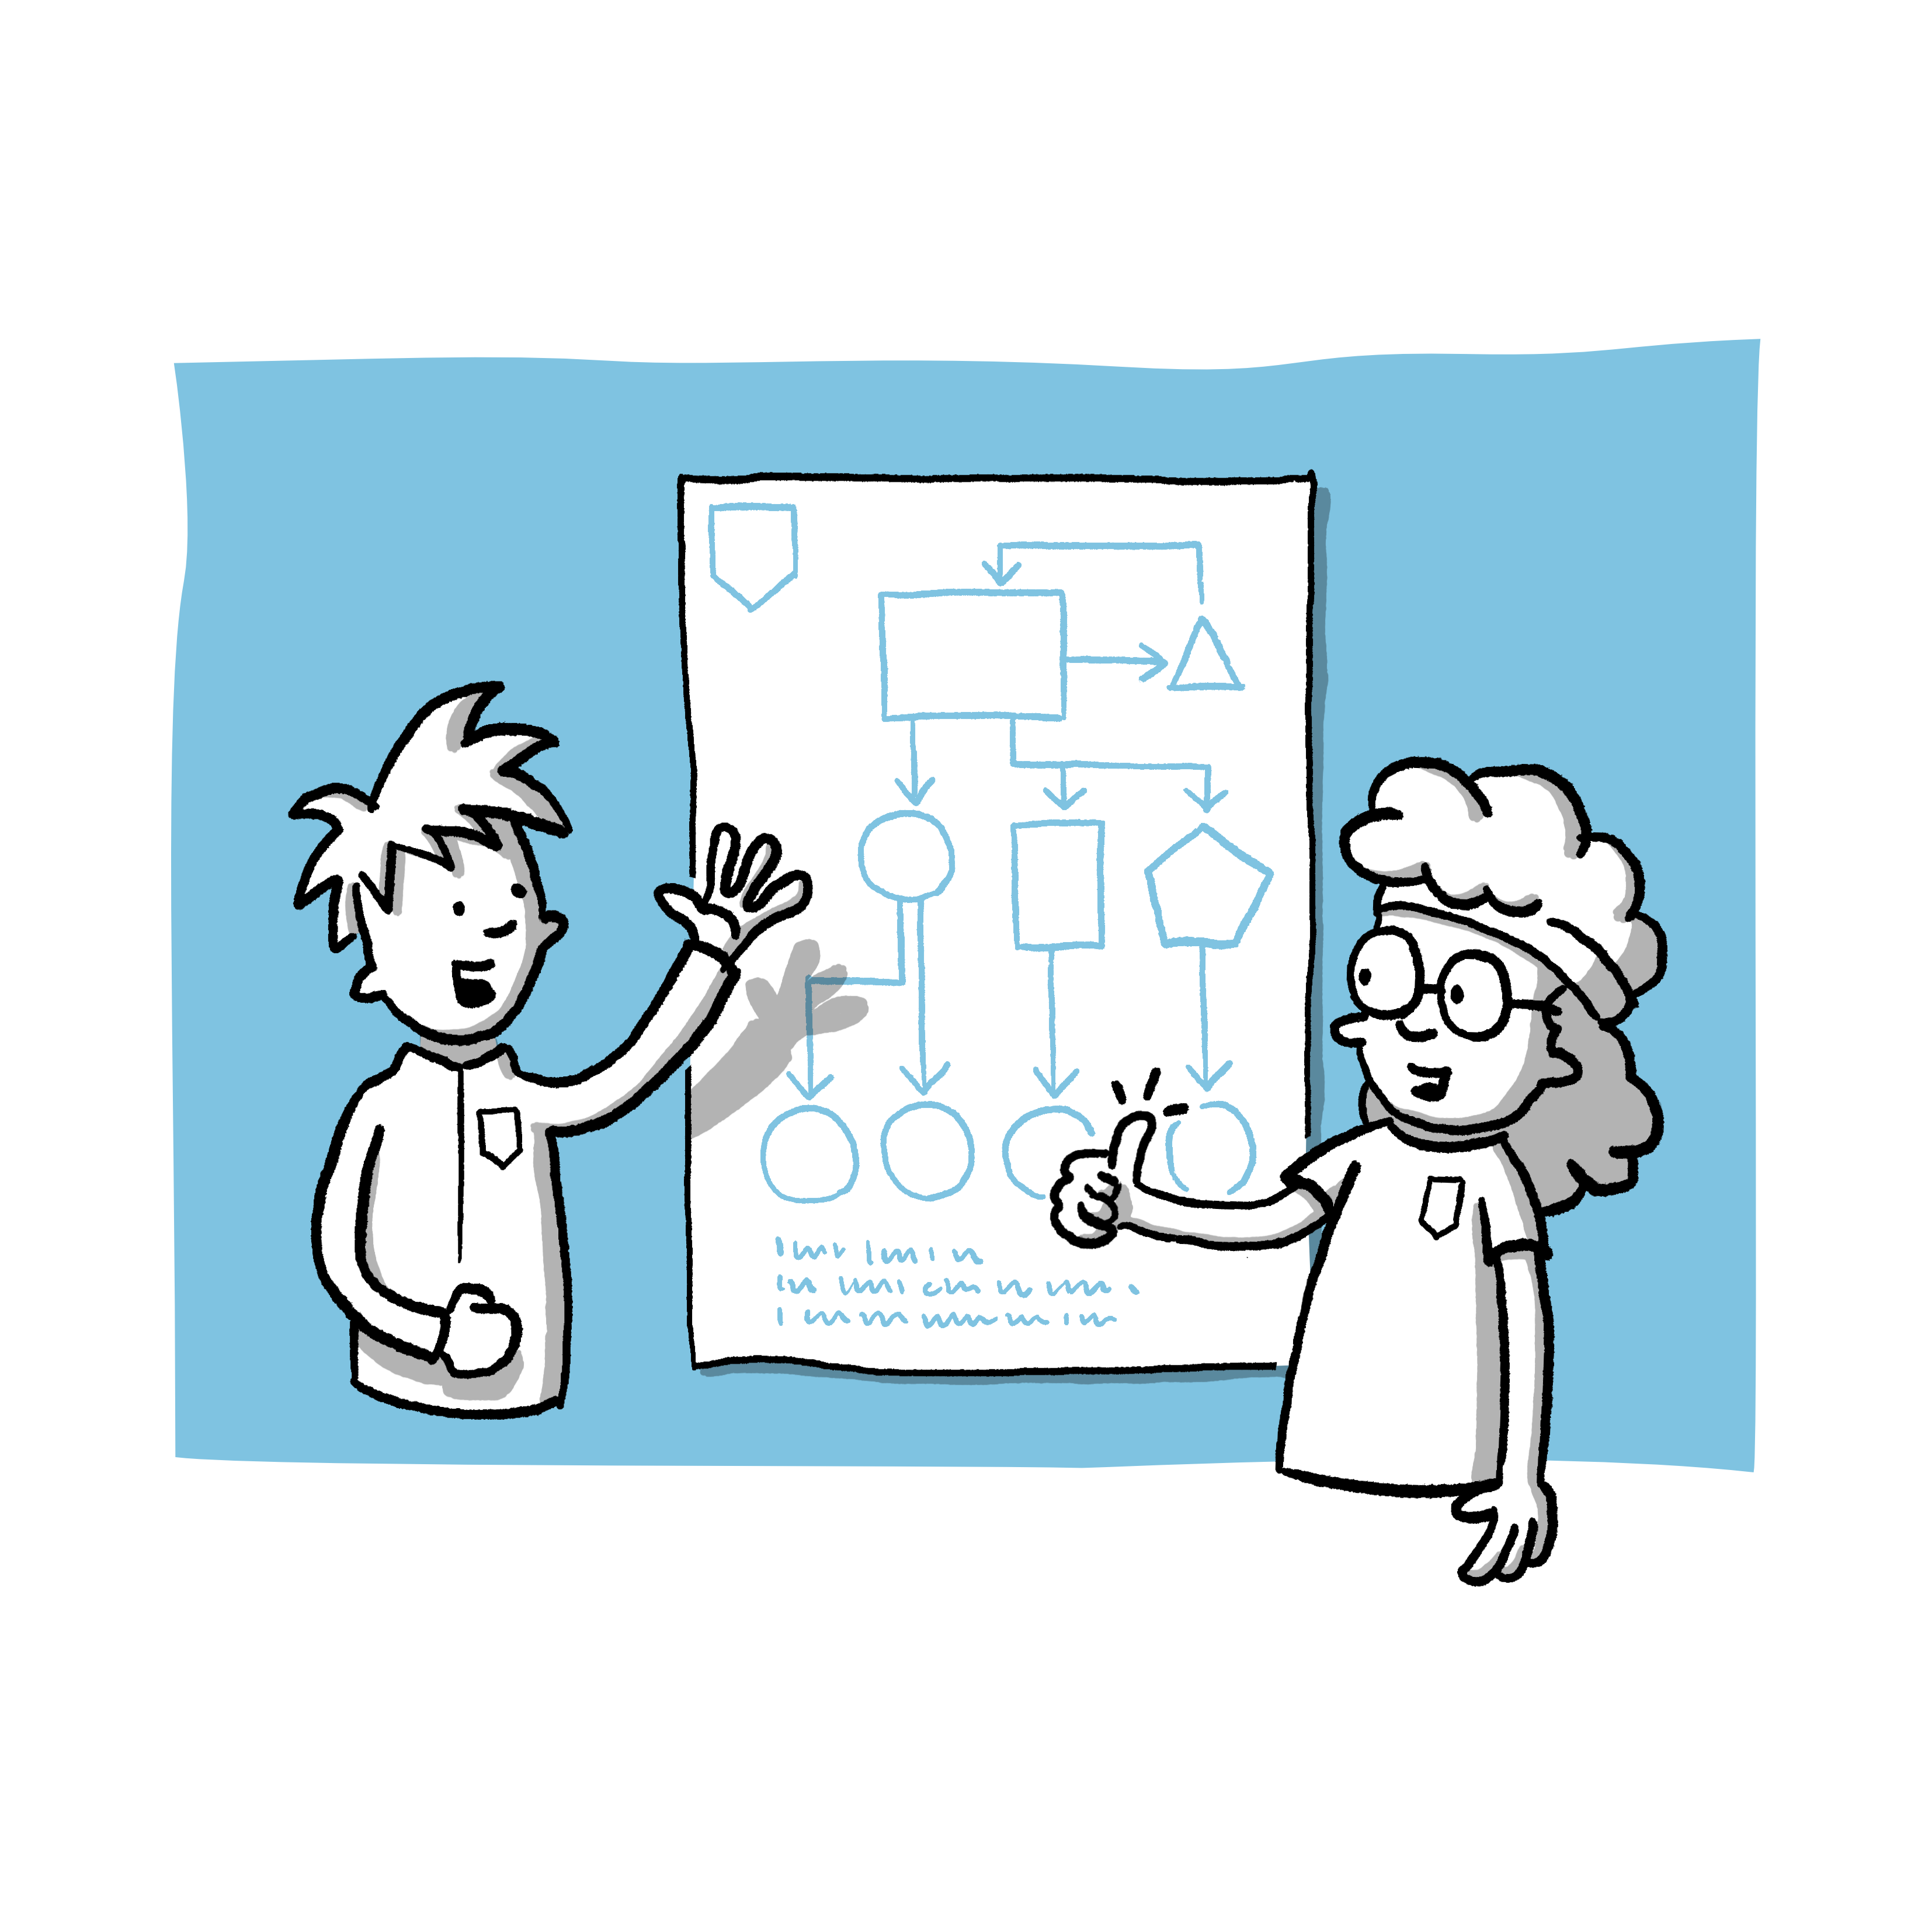
Take-Home Message
Notes:
Reflect in the group (it is best to choose one question), e.g. with a quick flash round:
How did you like the workshop?
What will you remember about the workshop?
What is the most important thing you took away from today's workshop?
This could be summarised as securing results:
Discussing special features in sport and options for action
List drawn up for empowering climate in training sessions
Action planning for the upcoming training sessions

Slide 31

Possible offers of help
Contact persons in the organisation
Name local contact points/cooperation partners
Name contact points of the association/state sports association or similar
SafeSport point of contact:
  https://www.ansprechstelle-safe-sport.de
  Phone: +49 (0)800 11 222 00
Nummer gegen Kummer:
  https://www.nummergegenkummer.de
  Phone: 116 111
Help portal for sexual abuse:
  https://www.hilfe-portal-missbrauch.de/en/home
  Phone: +49 (0)8002255530
Notes:
Finally, the participants should have the opportunity to find out about further offers of help.
Please adapt this slide to the respective sports club and region.
Please note that the contact points and their availability may change in the meantime, so please check the links and telephone numbers provided.

Slide 32
Thank you very much for your attention!
Are there any questions?
Notes:
Give the participants another opportunity to ask questions.
You can then end the workshop by thanking everyone for their participation and saying goodbye.
Please stay in the room for a while after the workshop so that participants have the opportunity to ask individual questions

Slide 33
Sources
Appleton, P. R., & Duda, J. (2016). Examining the interactive effects of coach-created empowering and disempowering climate dimensions on athletes' health and functioning. Psychology of Sport and Exercise, 26, 61–70. https://doi.org/10.1016/j.psychsport.2016.06.007.
Bartsch, F., & Rulofs, B. (2020). »Safe Sport«—Ein Handlungsleitfaden zum Schutz von Kindern und Jugendlichen vor Grenzverletzungen, sexualisierter Belästigung und Gewalt im Sport (1. Ed.). Deutsche Sportjugend. https://static-dsj-de.s3.amazonaws.com/Publikationen/PDF/Safe_Sport.pdf.
Duda, J. (2013). The conceptual and empirical foundations of Empowering CoachingTM: Setting the stage for the PAPA project. International Journal of Sport and Exercise Psychology, 11(4), 311–318. https://doi.org/10.1080/1612197X.2013.839414.
Duda, J., & Appleton, P. R. (2016). Empowering and Disempowering Coaching Climates: Conceptualisation, Measurement Considerations, and Intervention Implications. In M. Raab, P. Wylleman, R. Seiler, A.-M. Elbe, & A. Hatzigeorgiadis (Eds.), Sport and Exercise Psychology Research (pp. 373–388). Academic Press. https://doi.org/10.1016/B978-0-12-803634-1.00017-0.
Epstein, J. (1988). Effective schools or effective students? Dealing with diversity. In R. Haskins & B. MacRae (Eds.), Policies for America's public schools (pp. 89–126). Ablex.
Epstein, J. (1989). Family structures and student motivation: A developmental perspective. In C. Ames & R. Ames (Eds.), Research on motivation in education (pp. 259–295). Academic Press.
Greither, T., & Ohlert, J. (2023). Empowering and disempowering climate and experiences of psychological violence in artistic gymnastics. German Journal of Exercise and Sport Research. https://doi.org/10.1007/s12662-023-00886-7.
McMahon, S., & Banyard, V. L. (2012). When Can I Help? A Conceptual Framework for the Prevention of Sexual Violence Through Bystander Intervention. Trauma, Violence, & Abuse, 13(1), 3–14. https://doi.org/10.1177/1524838011426015.
Ohlert, J., Schmitz, H., Schäfer-Pels, A., & Allroggen, M. (2022). An Empowering Climate as a Protective Factor against Sexual Violence in Sport? Social Sciences, 11(8), 330. https://doi.org/10.3390/socsci11080330.
Rulofs, B., Gerlach, M., Kriscanowits, A., Mayer, S., Rau, T., Wahnschaffe-Waldhoff, K., Wulf, O., & Allroggen, M. (2022). SafeInSport: Sexualisierte Grenzverletzungen, Belästigung und Gewalt im organisierten Sport – Häufigkeiten und Formen sowie der Status Quo der Prävention und Intervention. Deutsche Sporthochschule Köln & Universitätsklinikum Ulm. https://www.dshs-koeln.de/fileadmin/redaktion/Aktuelles/Meldungen_und_Pressemitteilungen/2022_PDFs_PM/Bericht_SicherImSport.pdf.
Rulofs, B., Wahnschaffe-Waldhoff, K., Neeten, M., & Söllinger, A. (2022). Case study - Sexualised violence and child sexual abuse in the context of sport. Unabhängige Kommission zur Aufarbeitung sexuellen Kindesmissbrauchs. https://www.aufarbeitungskommission.de/wp-content/uploads/Sexueller-Kindesmissbrauch-Kontext-Sport_Studie_Aufarbeitungskommission_bf.pdf.
Notes:
Quellen- und Literaturangaben

Slide 34
Citation reference
If you would like to cite this workshop concept, please use the following citation reference:
Greither, T., Schmitz H., Sulprizio, M., Allroggen, M., & Ohlert, J. (2025). Gamechanger - How coaches create a training environment that motivates and strengthens athletes. German Sport University Cologne and University Hospital Ulm.

Slide 35
Imprint
Publishers
German Sport University Cologne
Psychological Institute
Dept. of Health & Social Psychology
Am Sportpark Müngersdorf 6
50933 Cologne, Germany
www.dshs-koeln.de/psychologisches-institut/
University Hospital Ulm
Clinic for Child and Adolescent Psychiatry, Psychosomatics, and Psychotherapy
Research Group Violence, Developmental Psychopathology, and Forensics
Steinhövelstraße 5
89075 Ulm, Germany
https://www.uniklinik-ulm.de/kinder-und-jugendpsychiatrie-psychosomatik-und-psychotherapie.html
Available from
"SafeClubs" project - transfer concepts for the prevention and intervention of sexual violence in sports clubs
Collaboration management: Dr. Jeannine Ohlert (German Sport University Cologne)
Sub-project management: Dr. Jeannine Ohlert, Univ. Prof. Dr. Bettina Rulofs (both German Sport University Cologne), Prof. Dr. med. Marc Allroggen,
Dr. Alina Schäfer-Pels (both University Hospital Ulm)
Collaboration coordination: Marion Sulprizio (German Sport University Cologne)
Collaboration: Helena Schmitz, Annika Söllinger, Janna Kerkow, Sina Kiekbusch, Paula Edler (all German Sport University Cologne), Teresa Greither
(University Hospital Ulm)
https://safe-clubs.de

Slide 36
Imprint
Authors
Teresa Greither^{1,2}, Helena Schmitz³, Marion Sulprizio³, Marc Allroggen^{1,2} & Jeannine Ohlert^{3,4}
¹ University Hospital Ulm, Clinic for Child and Adolescent Psychiatry, Psychosomatics, and Psychotherapy
² German Center for Mental Health (DZPG), partner site Ulm
³ Psychological Institute, German Sport University Cologne
⁴ German Research Centre of Elite Sport (momentum), Cologne
With contributions from Janna Kerkow, Sina Kiekbusch, Vivian Gast (all German Sport University Cologne)
Image credit Marcel Jansen, Instagram: @mrcl_cartoons
Funding Acknowledgment The project underlying this report was funded by the Federal Ministry of Education and Research under the grant number 01SR2106A. The responsibility for the content of this publication lies with the authors.
Publication Date: January 2025 – Digital Version
Copyright © German Sport University Cologne and University Hospital Ulm, 2025
All Rights Reserved Without the express permission of the University Hospital Ulm and the German Sport University Cologne, it is not permitted to reproduce the content of this presentation or parts thereof by photographic, printing, or digital means for commercial purposes.
Texts, tables, and graphics may gladly be used for voluntary work, including in sports federations and clubs.

